Slide 1
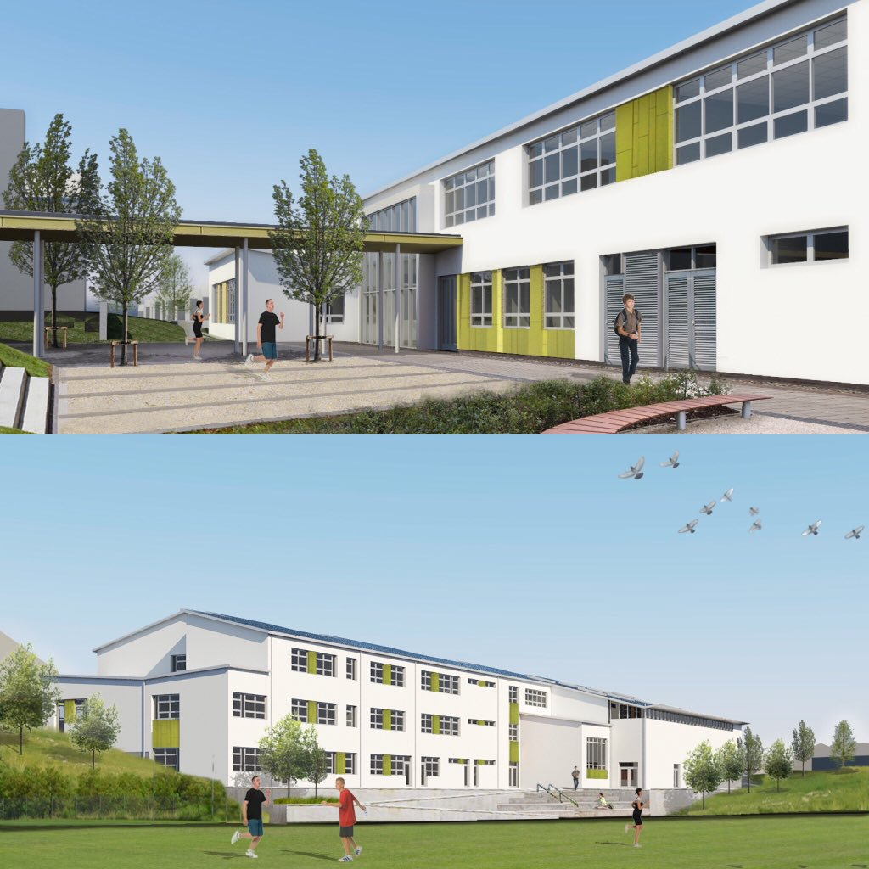
COLÁISTE AN CHRAOIBHÍN

Slide 2
A brief guide
to the
Transition Year Programme 2024/2025

Slide 3
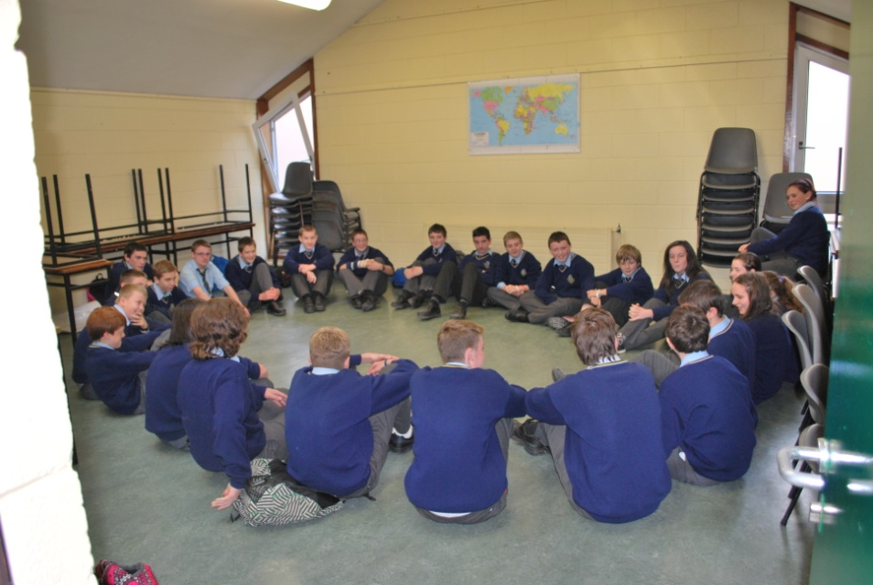
Transition year
Transition Year is an optional “one year school-based programme between Junior & Senior Cycle designed to act as a bridge between the two by facilitating the smooth transition from the more dependent learning of the Junior Certificate to the more independent learning required for Senior Cycle”
(Department of Education & Science)

Slide 4
Benefits of transition year
Students who have taken the TY programme had a higher-grade average in the Leaving Certificate as well as an increased entry level to higher education.
Students are also found to take a broader range of courses at higher level than non-Transition Year students
(Economic & Social Research Institute)
(

Slide 5
TRANSITION YEAR OFFERS STUDENTS a chance to:
Experience a Broad Curriculum of subject options
Develop New Skills
Avail of New Opportunities
Experience the World of Work
Think about the Future & potential Career Options
Experience the World Abroad
Mature

Slide 6
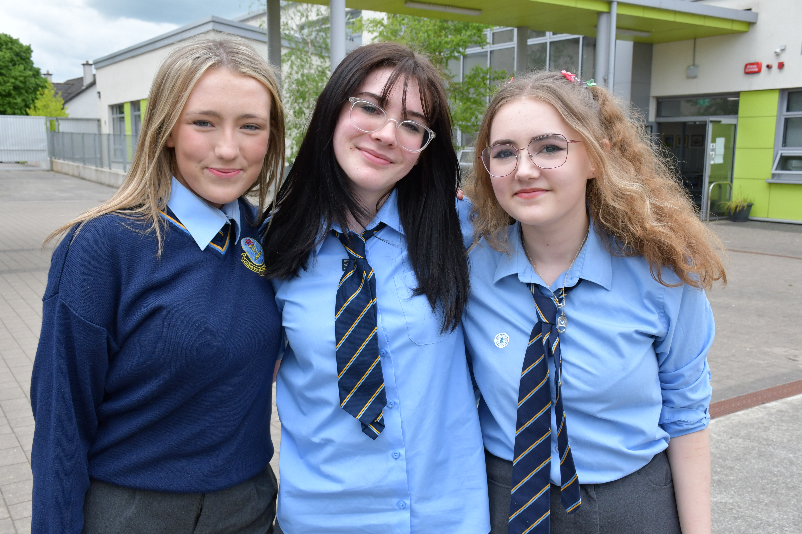
Peeling back the layers of the ty programme

Slide 7
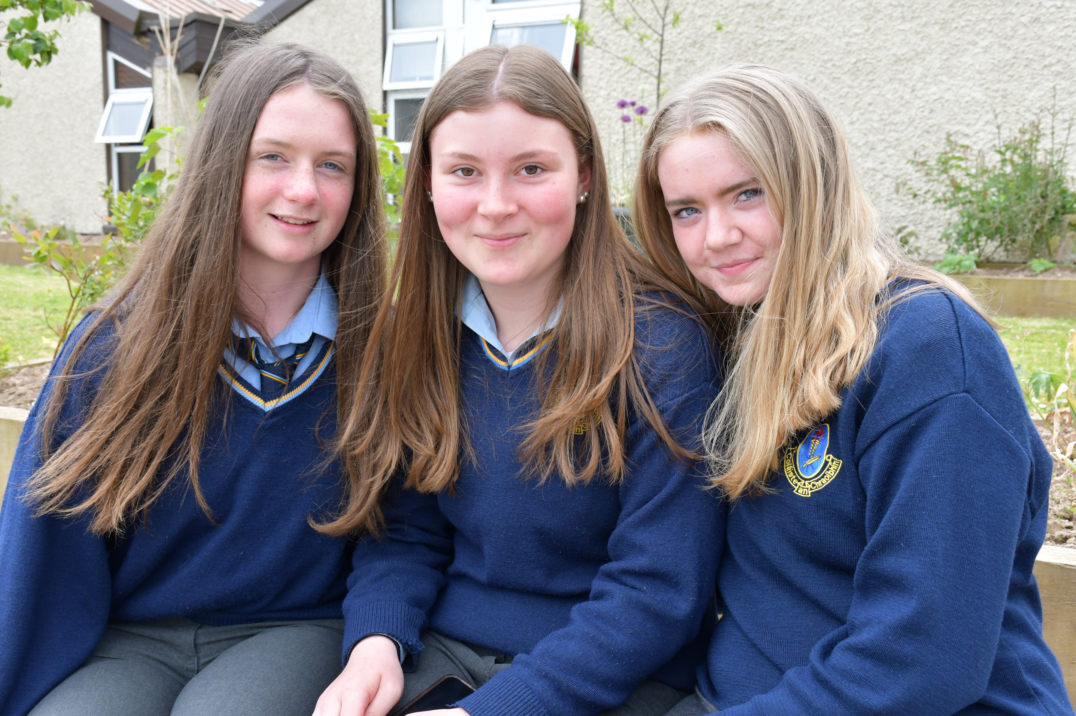
Core subjects- (Compulsory year long subjects):
core subjects
Compulsory Subjects
Other Subject Rotation
Wellbeing
ICDL (International Certificate of Digital Literacy)
Work Experience/Career Guidance
Mini-company/Enterprise
Physical Education
English
Irish
Maths
French/German

Slide 8
Subject sampling layer- (Sampling of OPTIONAL Leaving Certificate Examinations subjects:)
History
Geography
Home Economics Music
LC PE
Computer Science
Construction
Engineering
DCG
Business
Economics
Accounting
LCVP
Art
Biology
Chemistry
Physics
Agricultural
Science

Slide 9
students who completed transition year
“were more likely to retain subjects at higher level, to move from Ordinary level to Higher level & from Foundation to Ordinary Level.
“were also more likely to take up subjects which they had not taken before”
(National Council for Curriculum and Assessment)

Slide 10
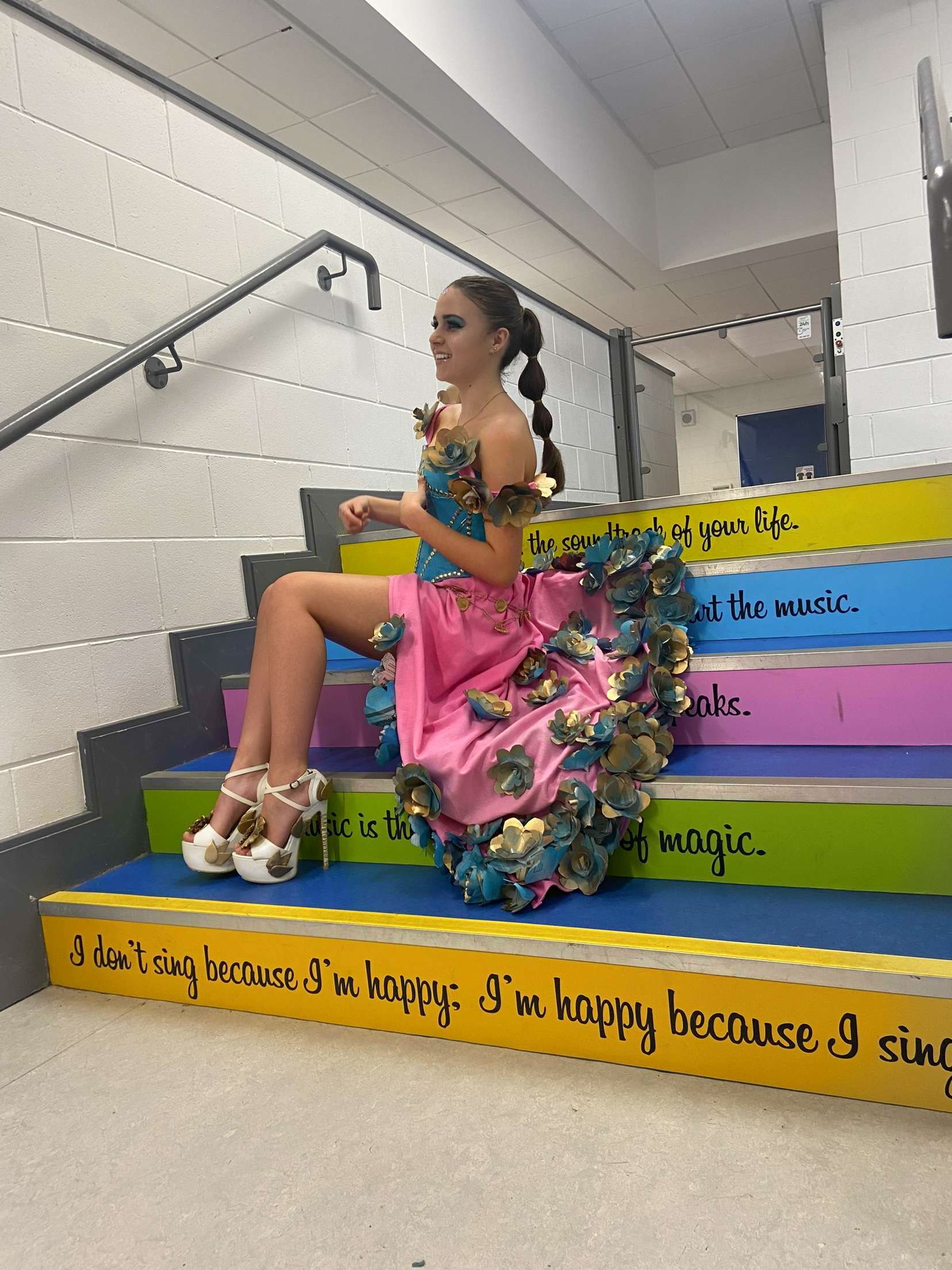
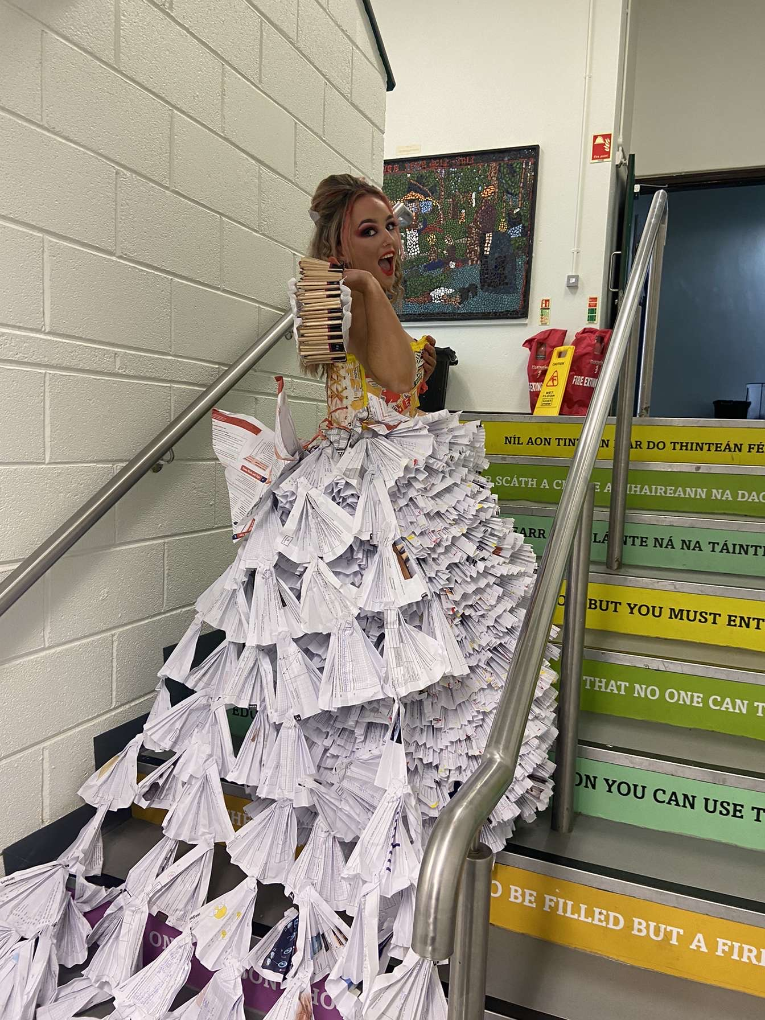
TY Specific Layer- (Sampling of Other topics/subjects)
Politics
Creative Writing
Choreography/Dance
Artistic Performance
Education for Living
Gaisce
DIY
Green schools
Craft
Public Speaking
Robotics
Media Studies
Safety
Bystander Intervention
Biodiversity
Reflective Practice
Junk Kouture
Young Scientist
Big Idea!
Yoga

Slide 11
Once off calendar layer- (Other Learning Experiences:)
Work experience placements (x3)
Trip to the Gaeltacht (x2 nights)
First Aid/CPR
Driving School/Car Safety
Swimming
Apprenticeships Seminar & Safe Pass Courses
Cinema Trip, Airtastic & Perks
GAA Future Leaders

Slide 12
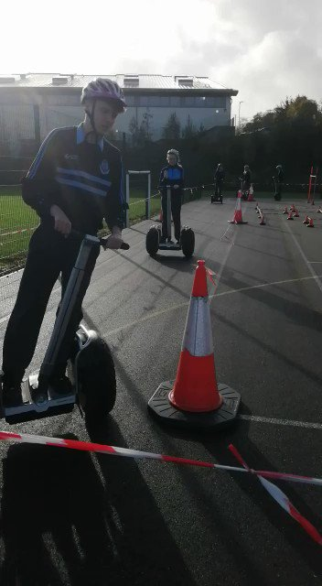
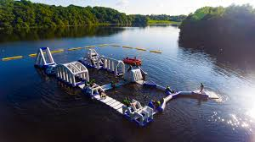
Other Learning Experiences:
Cycle against Suicide
STEM Passport for inclusion
Movie Magic & Law Courses
Waterford Greenway Cycle
Segways
Gym Work (Rejuvenate)
Kayaking &Team Building Skills (Ballyhass/Zipit)
Douglas Cookery School
Hospitality/Barista Course
Newsletters CV construction & Interview Preparation

Slide 13
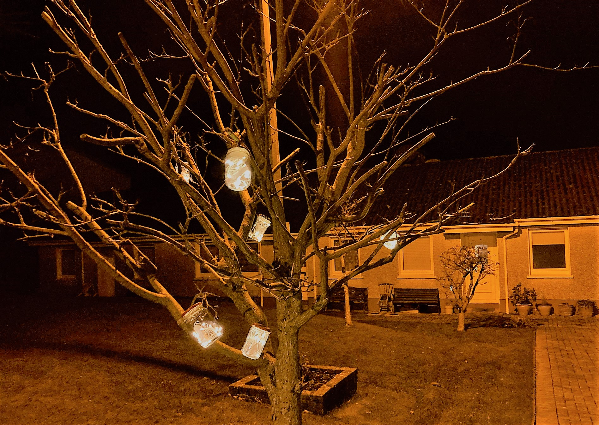
Other Learning Experiences:
Lift leadership
JFK Forensic Workshop
Buddy/1st year merits
Model United Nations
Charity Work/Trips/Talks
(Marie Keating Foundation, Drugs Awareness, Cork Guide Dogs, Daffodil Day)
Enterprise Trips (Eg: APPLE & LAYA)
Community Care (Eg: COPE Foundation & Cluan Dara)

Slide 14
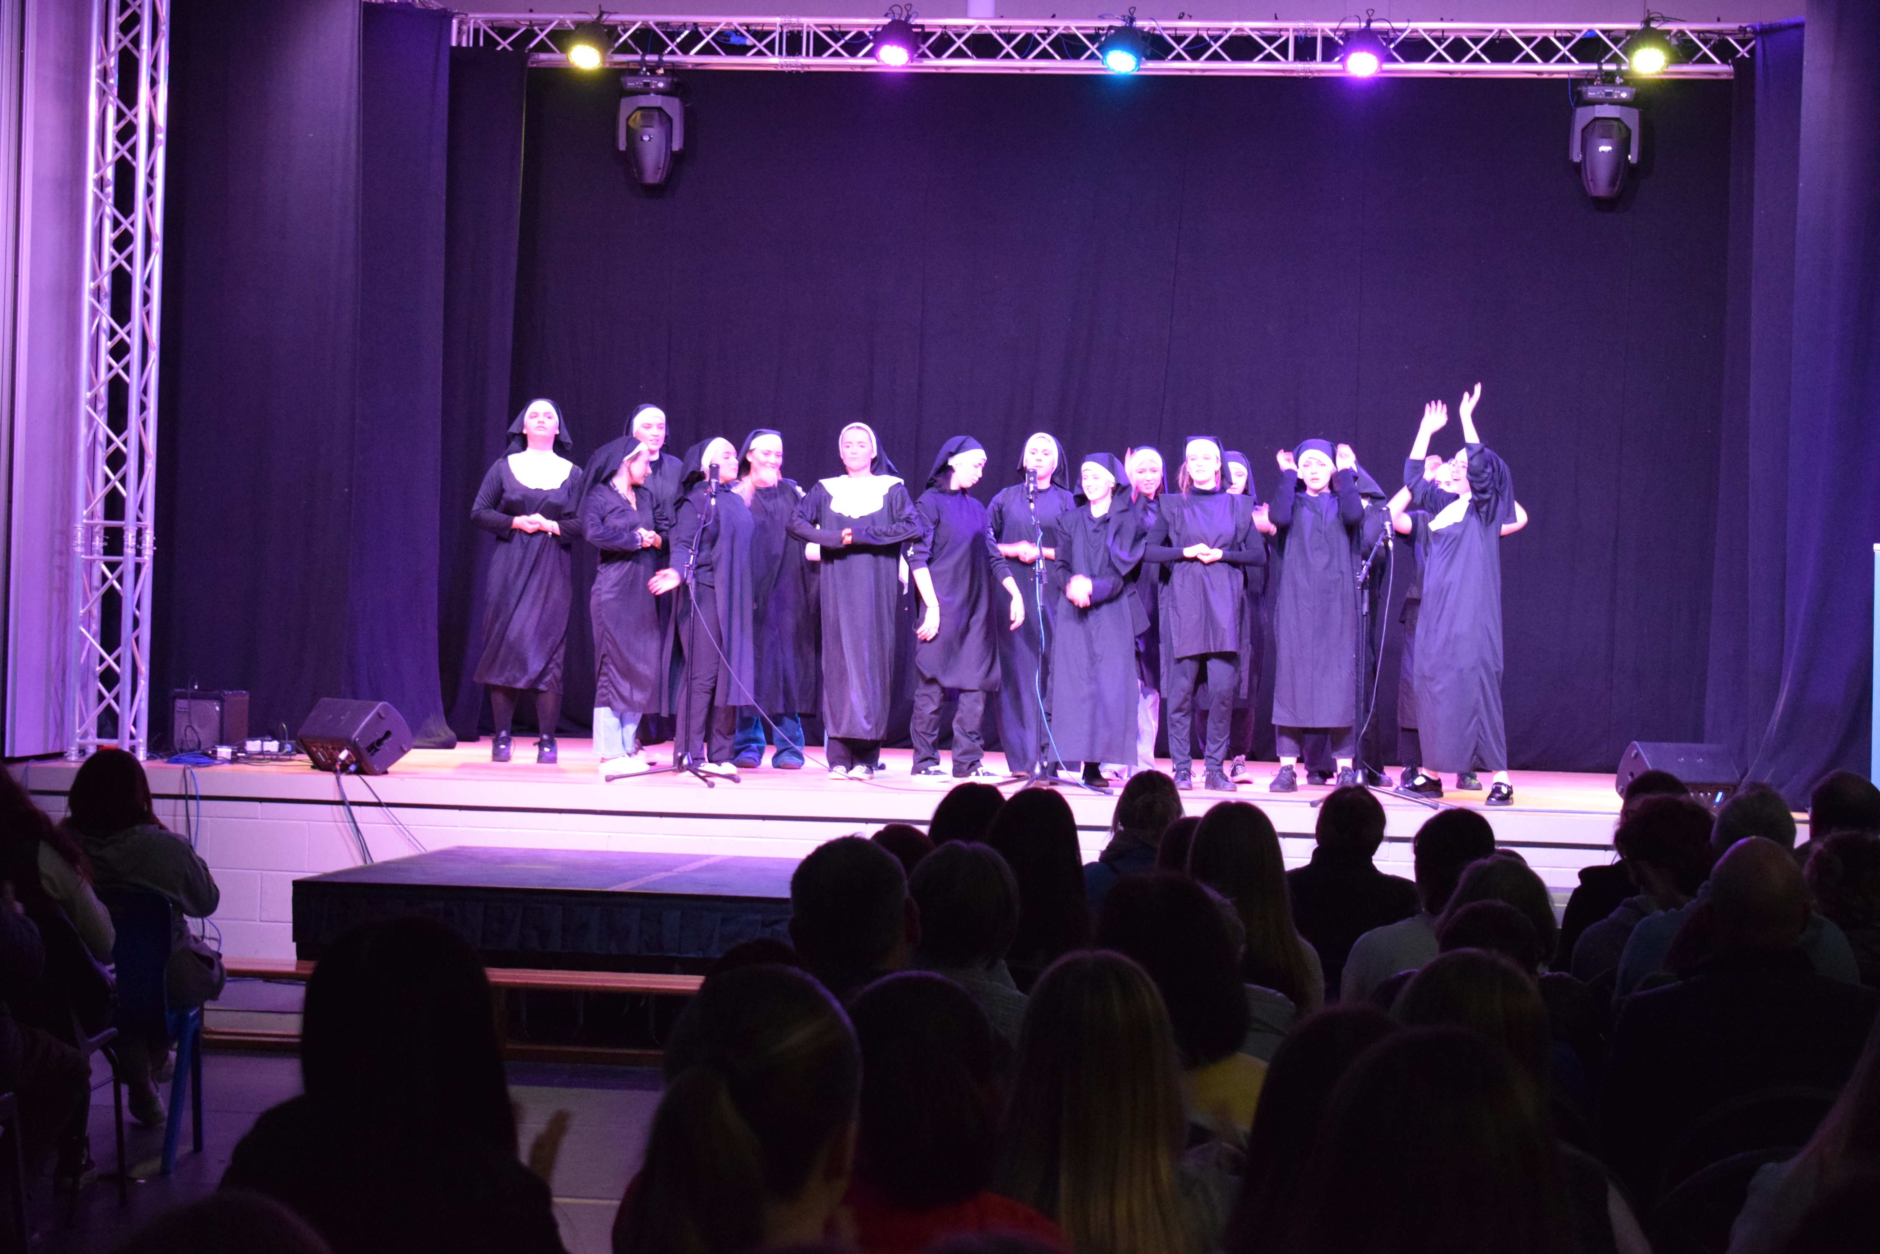
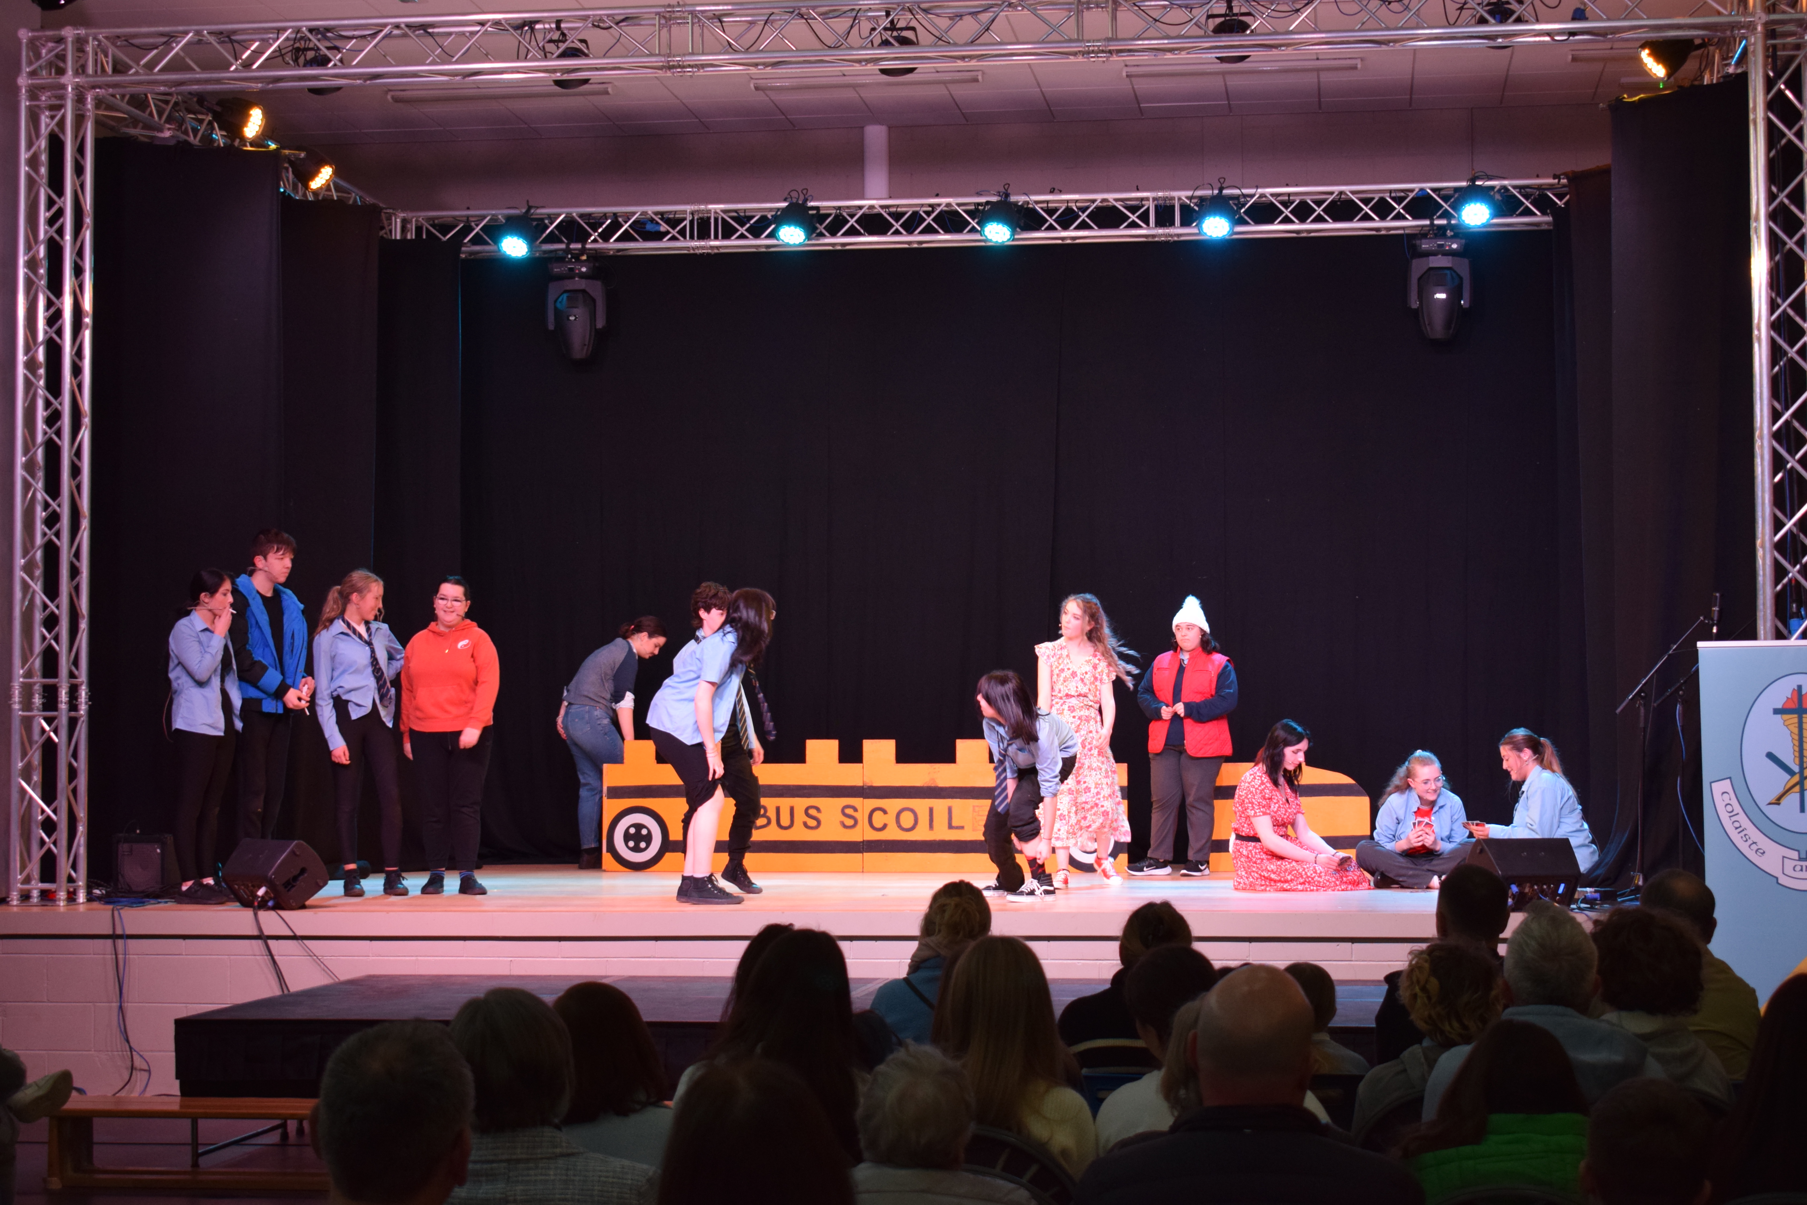
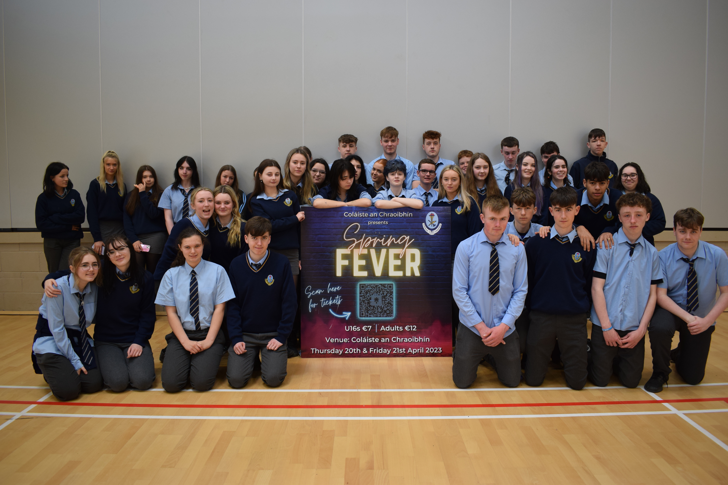
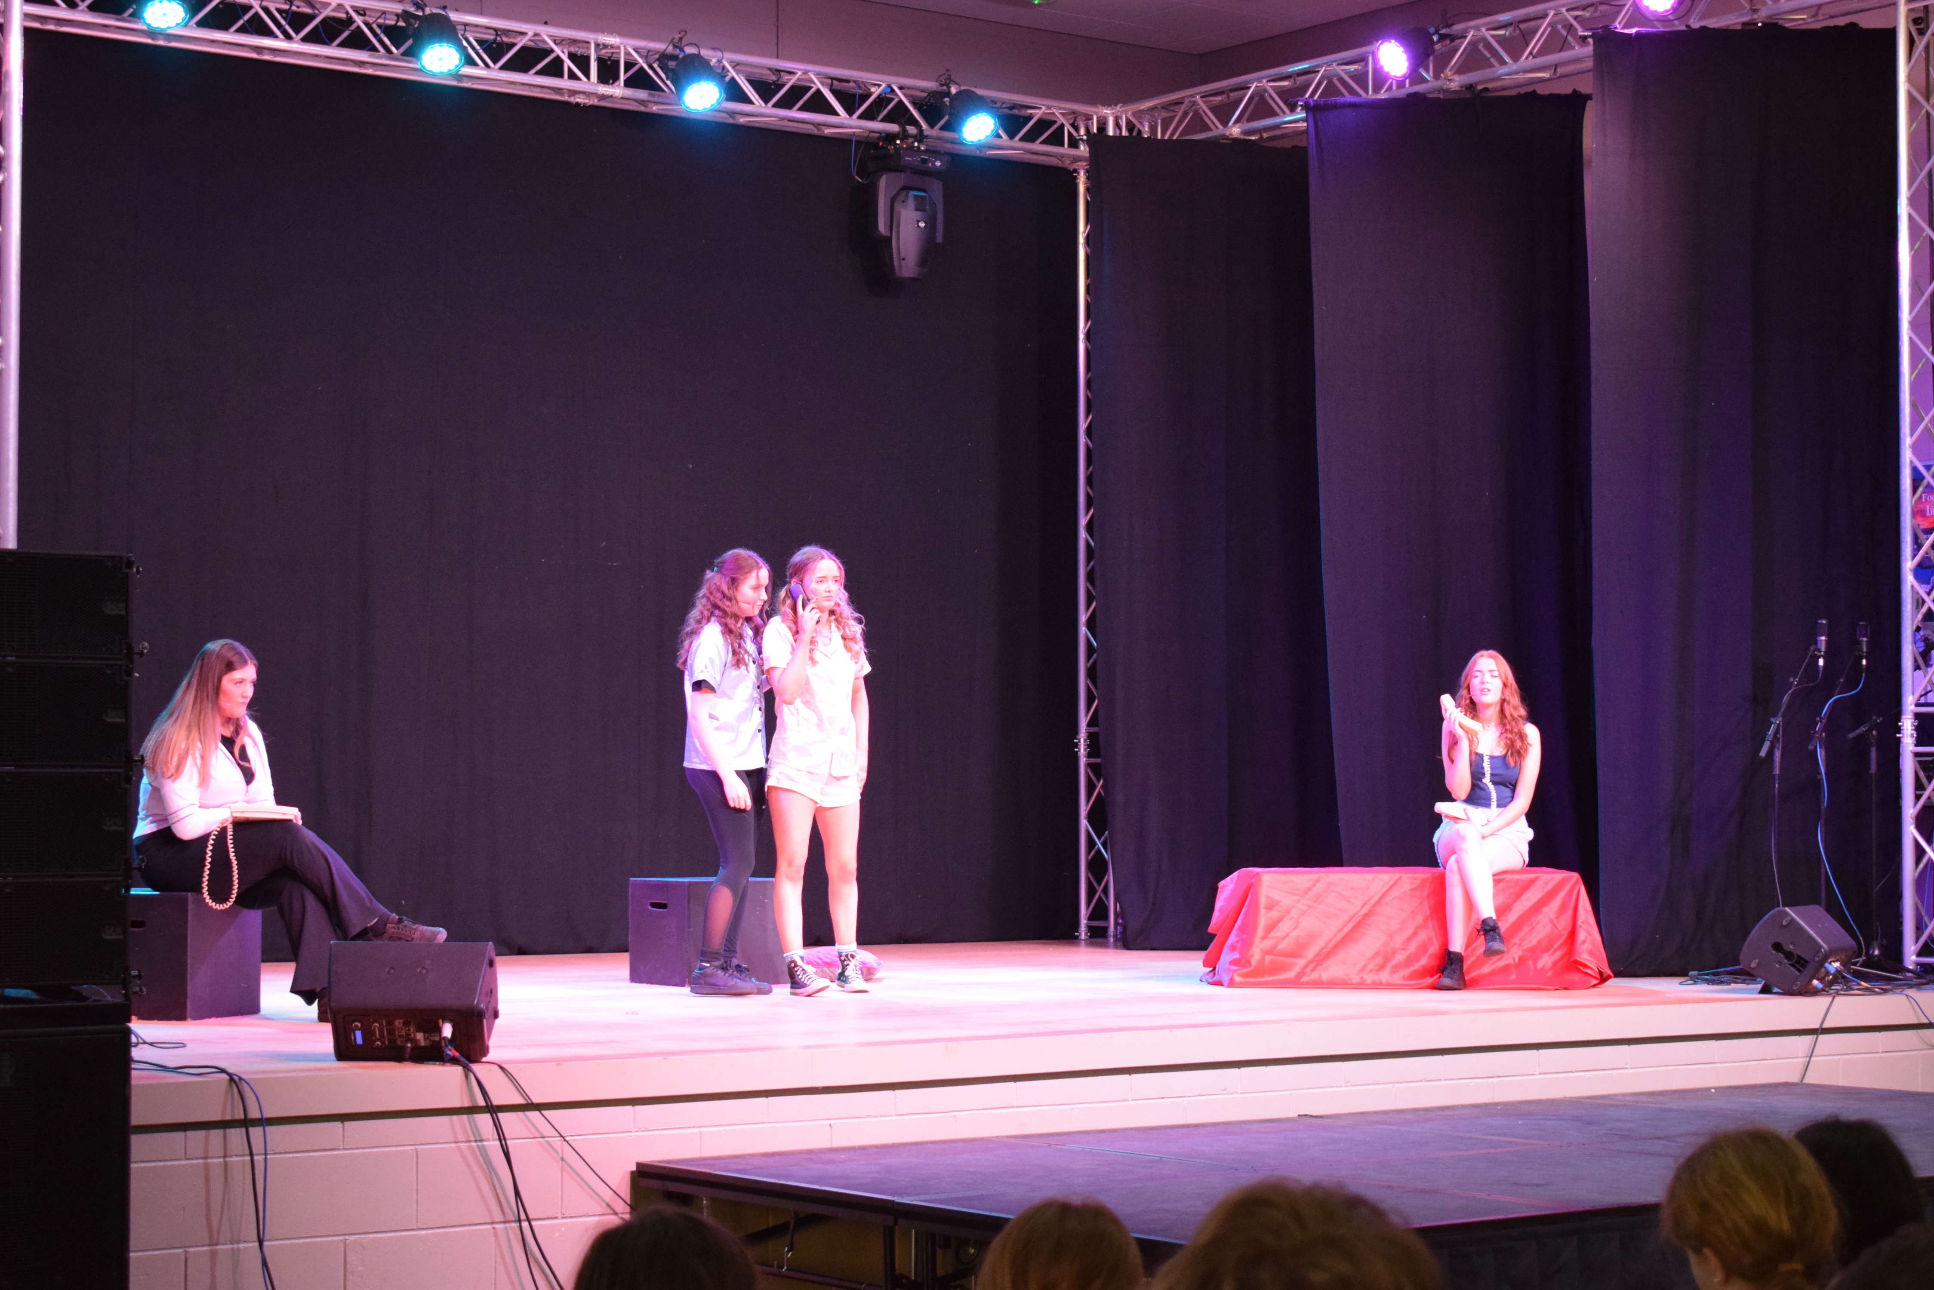
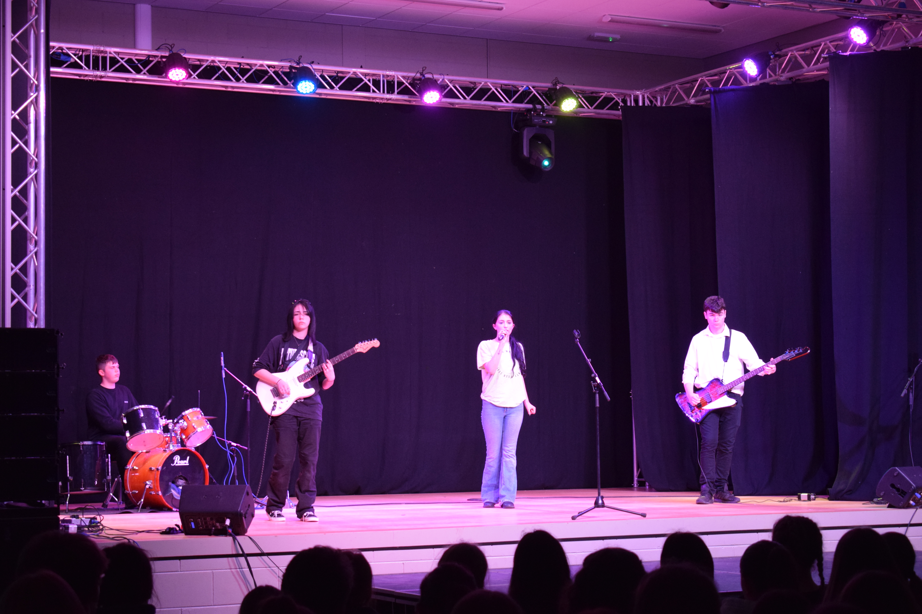
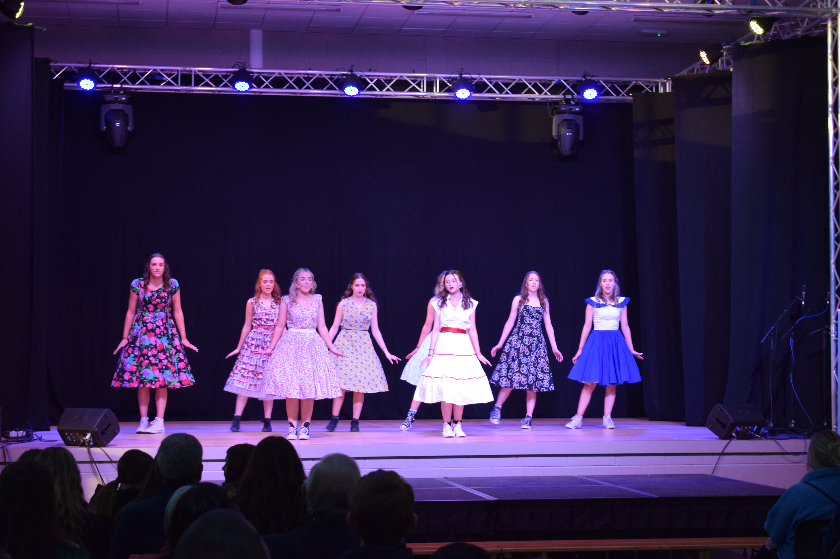
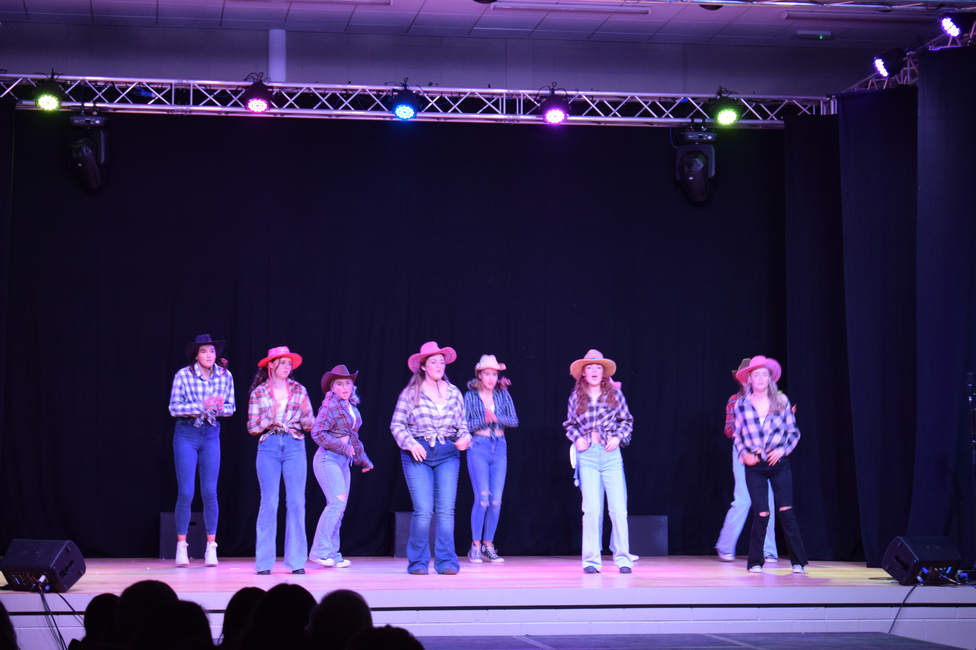
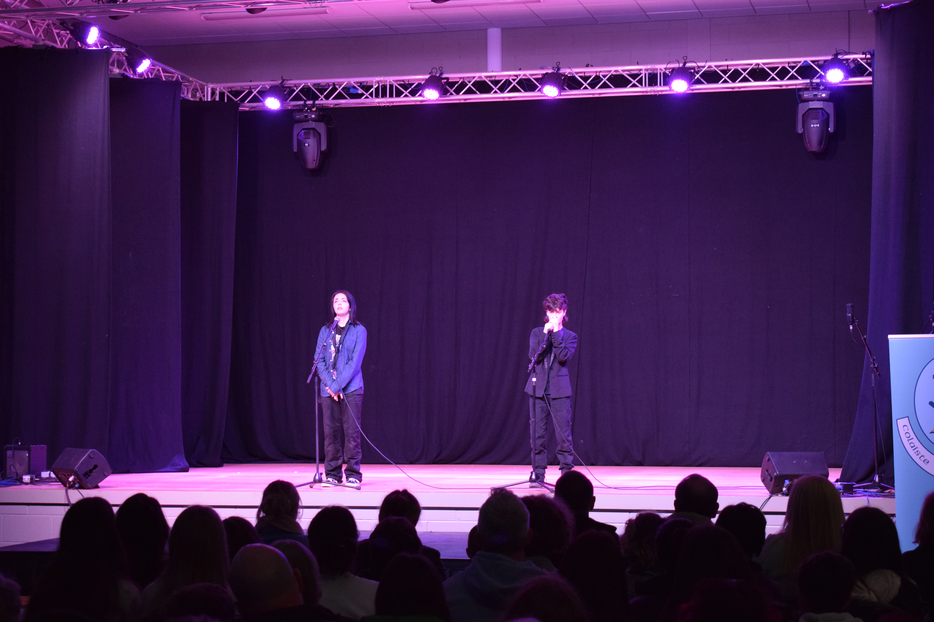
TY show/Musical:

Slide 15
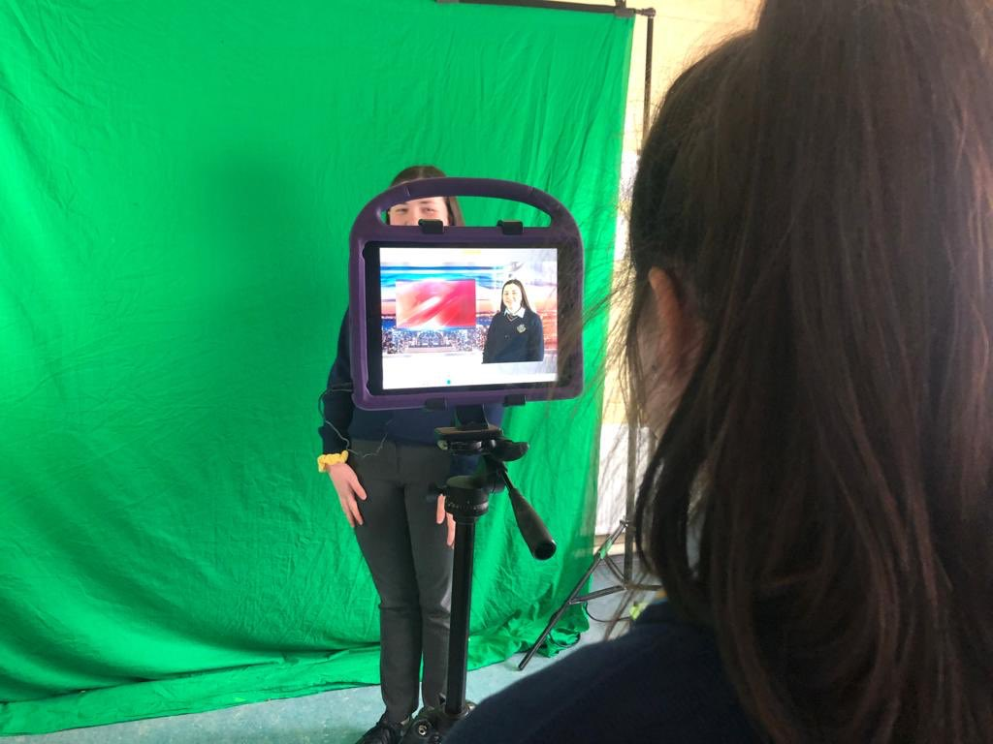
“Students who have taken the TY Programme are more self-reliant learners when they enter third level education than their peers”
(Commission on the Points System)

Slide 16
WHO SHOULD DO TRANSITION YEAR?
Someone who is positive & who wants to gain additional skills (Eg: Leadership)
Someone who wants a chance to build up their CV with new experiences.
Someone who wants to become more confident, mature & independent.
Someone who is willing to get involved
in group activities & project work.

Slide 17
WHO SHOULD DO TRANSITION YEAR!
Someone who could benefit from spending another year to develop as a person (Eg: confidence, communication skills etc)
Once in a lifetime opportunity to take part in new experiences
Someone who is still unsure of what they want to do in the future & wants extra time to make informed Leaving Certificate choices.

Slide 18
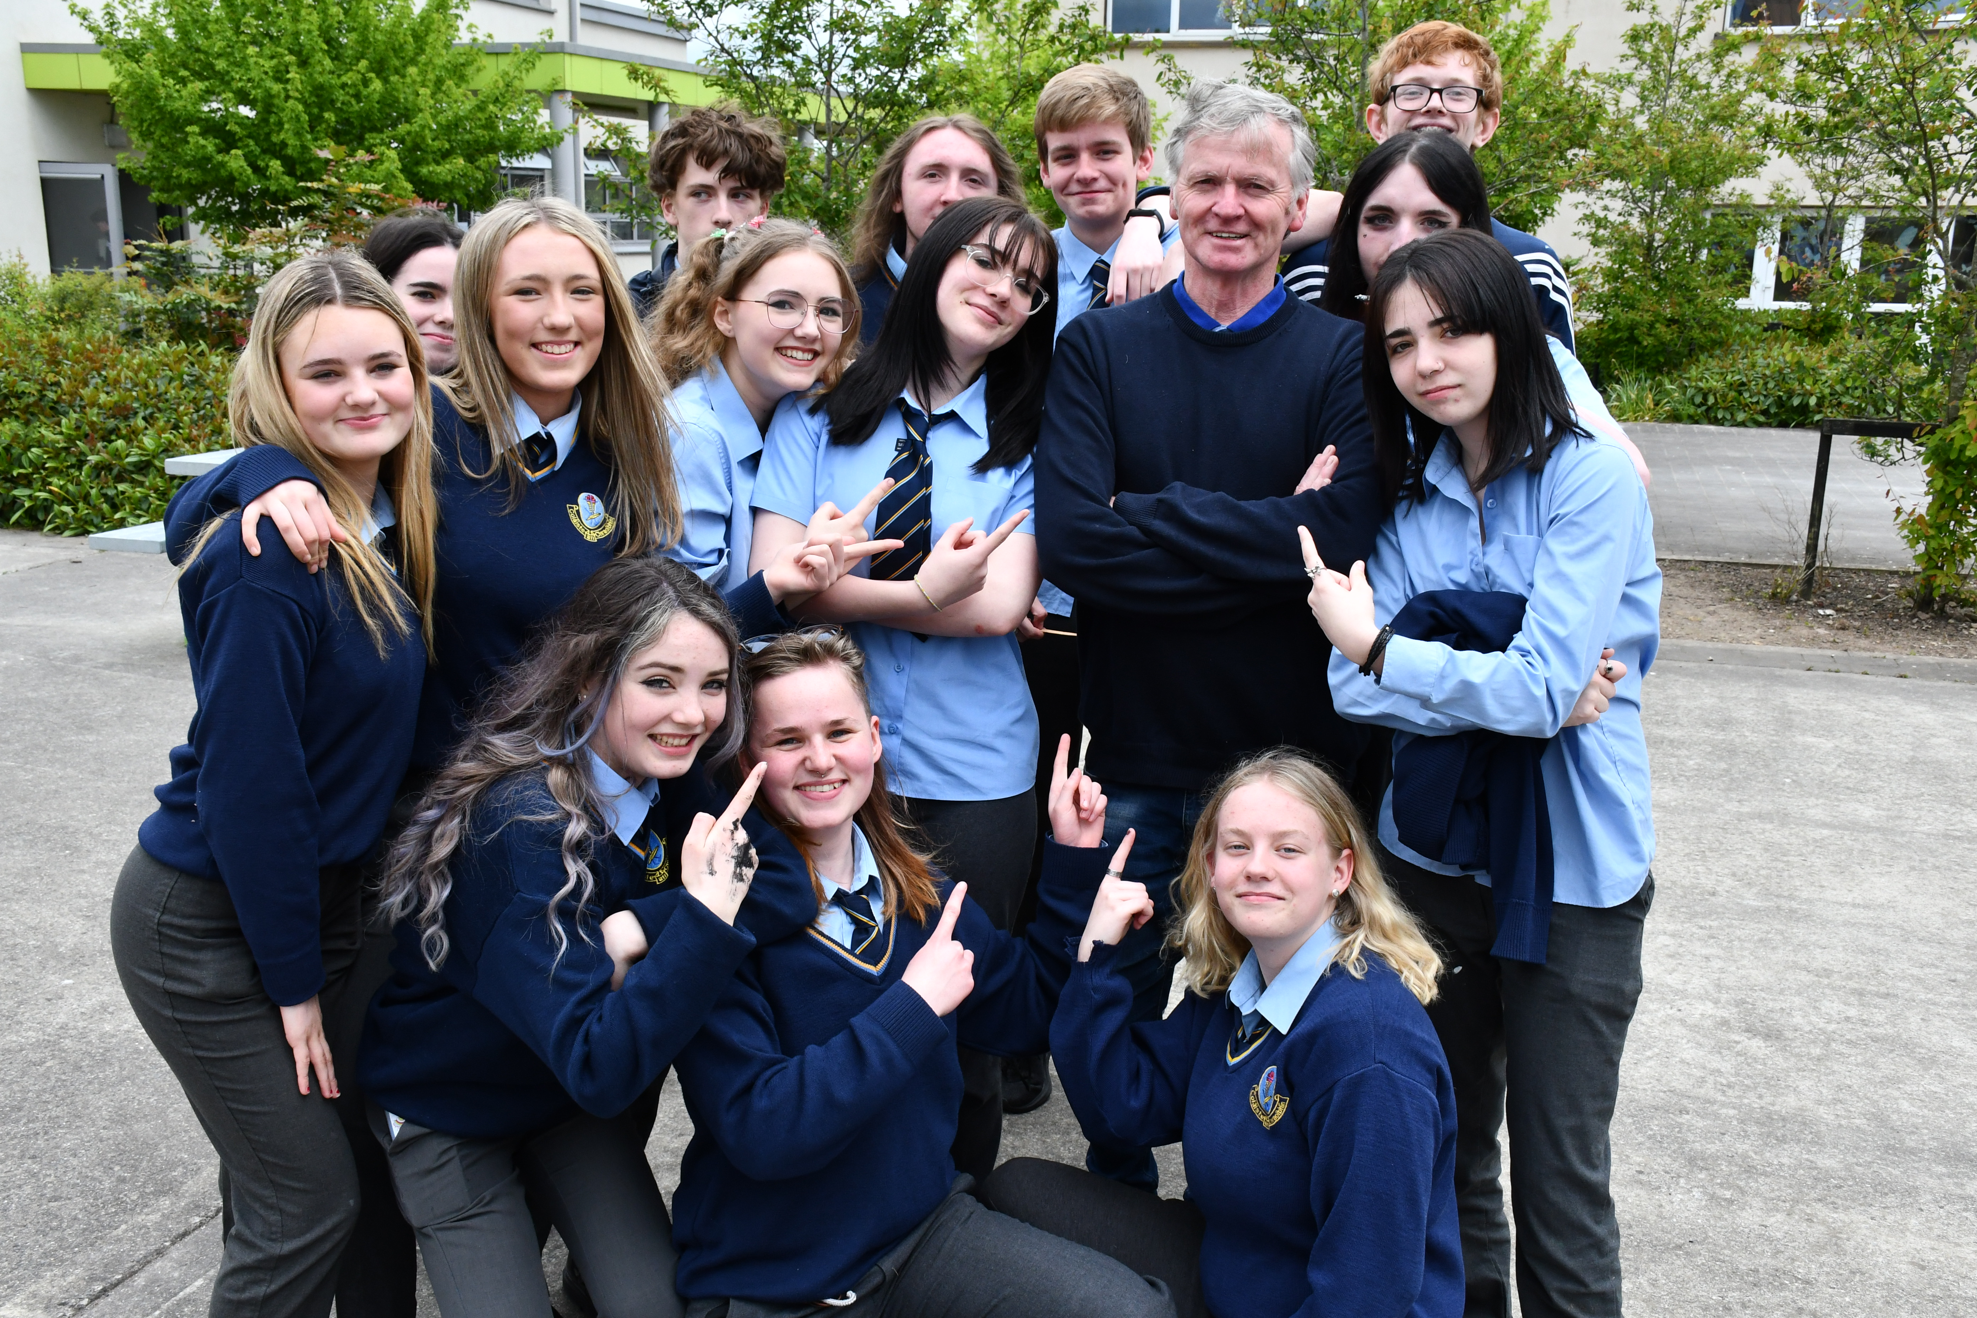
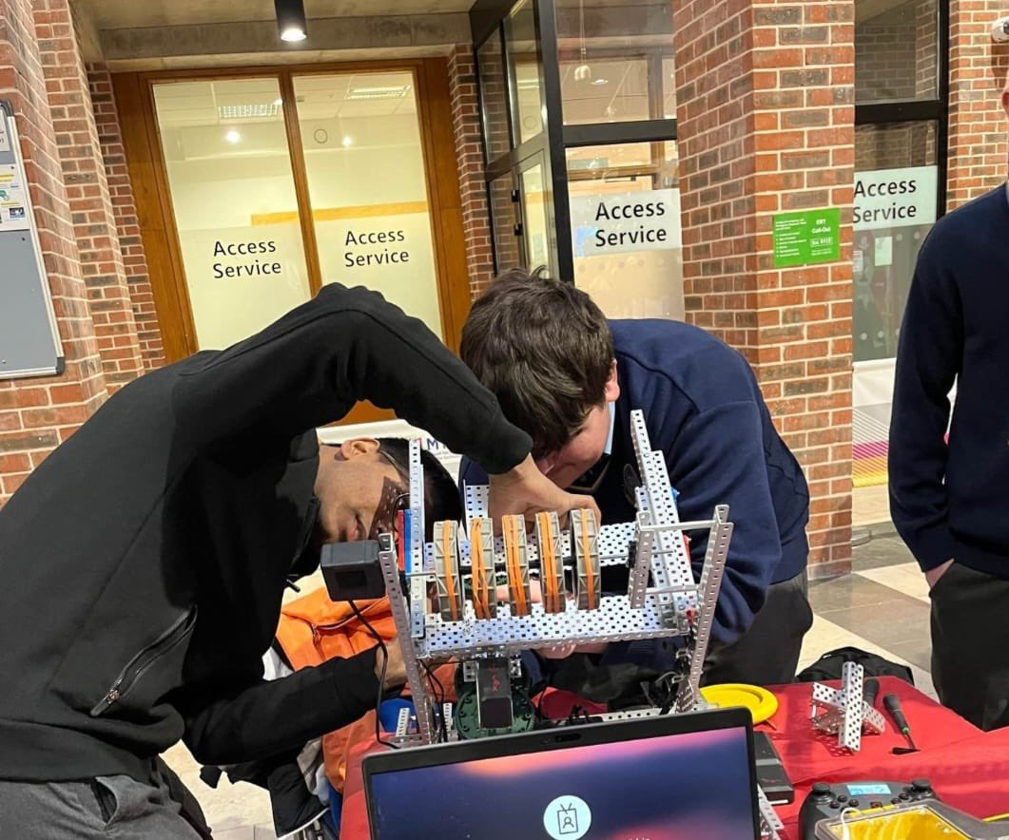
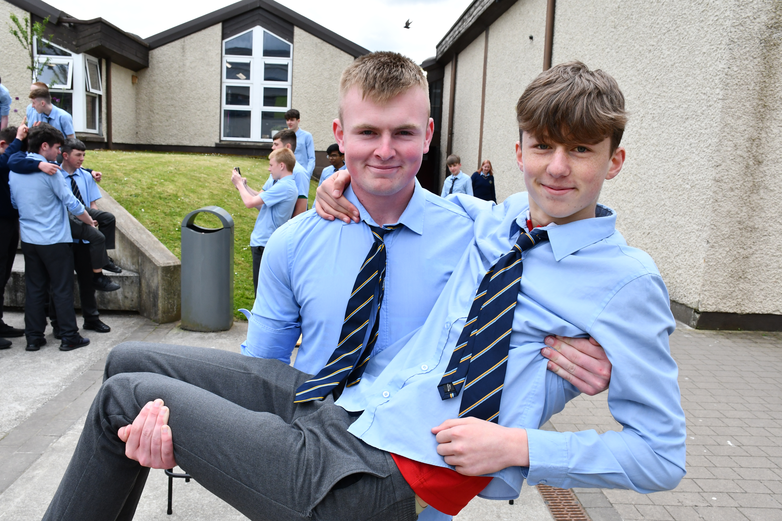
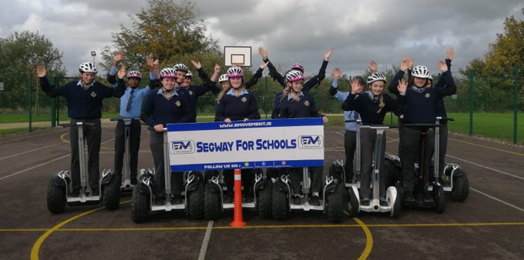

Slide 19
“Students who do transition year at second level get up to 40-45 more CAO points on average than those who do not and are also more likely to go on to third level education. ”
(Economic and Social Research Institute Study)

Slide 20
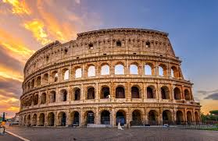
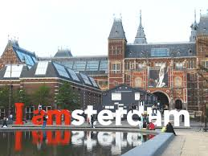
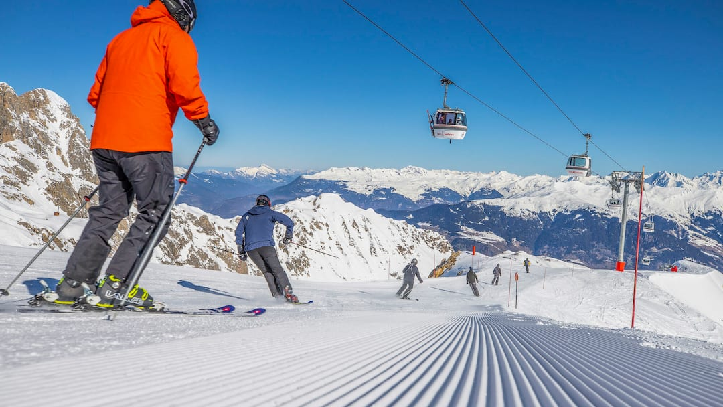
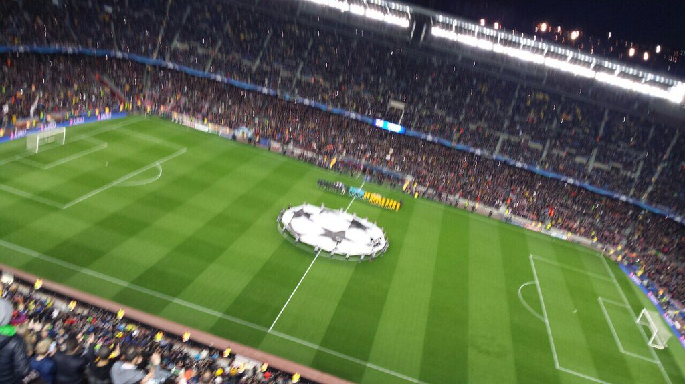
School tours

Slide 21
School tour example
GTI (Group Travel Specialists) have given me the following rough price plan:
Destination | Lake Garda, Gardaland theme park & Verona
Tour dates | April/ May 2025???
Duration | 4 days / 3 nights
Tour Price | Approx €700.00pp based on 45 paying students
Dates | Route |  | Depart / Arrive
April/May | Cork / Milan Bergamo |  | 14.45/18.10
April/May | Bergamo/ Cork |  | 10.35/12.15

Slide 22
Lake Garda
Price Includes:
Return flights from Cork or Shannon to Milan Bergamo with Ryanair -
10kg bag included
Executive coaching throughout Tour (within EU Drivers Regulations)
3 nights in hotel Centro Turistico or similar with breakfast & evening meals included
Boat cruise on Lake Garda
Excursion to Malcesine to enjoy a ride on the Monte Baldo Cable Car
Excursion to Sirmione to enjoy free time
Day trip to Venice
Full Day at Gardaland Theme Park
A visit to Verona with a guide.
Itinerary planning – our experienced staff will assist with all your itinerary planning
Comprehensive Travel Insurance at Premier Plus level which means that Travel Disruption is included automatically with your tour so you’re protected in the event of certain flight cancellations or delays - T&C apply
24-hour emergency contact whilst abroad manned by our own GTI staff

Slide 23
Your Hotel: 3* hotel in Lake Garda
https://hotellagodigardaconpiscina.it/
https://www.chincherinihotels.com/hotels/park-hotel-jolanda
https://centro-turistico-gardesano.worhot.com/
Students will be accommodated in triple/quad rooms
The hotel requires a security deposit on check-in of €10pp refundable on check-out
(Please note that city tourist tax applies to all those aged 14+. It costs €1pp per night; it is a local tax and needs to be paid directly to the hotel.)
Coaching:
Day 1 08 hours of continuous service from airport to drop off at your
Day 2 12 hours of continuous service from your hotel
Day 3 Transfer to the Gardaland theme park
Day 4 coach transfer from the hotel to the airport.

Slide 24
Optional extras:
A number of entrances can be added or substituted into your itinerary.
Pizza night €12.00 – evening meal.
How to Book:
To confirm, a non-refundable deposit of €250 is required from each paying person travelling. We have an online payment system where parents/guardians can pay us directly.
Final payment of full balance must be paid 10 weeks before departure
Terms and Conditions:
GTI is fully licensed and bonded in accordance with the Commission of Aviation Regulation (TA0533)
All deposits are non-refundable
Payments can be accepted by cheque / bank draft, by bank transfer or via our website - details available on request

Slide 25
“TY is a largely positive experience in which students appreciate getting a taste for different subjects & the opportunity to get work experience”
(Irish Second Level students’ Union)

Slide 26
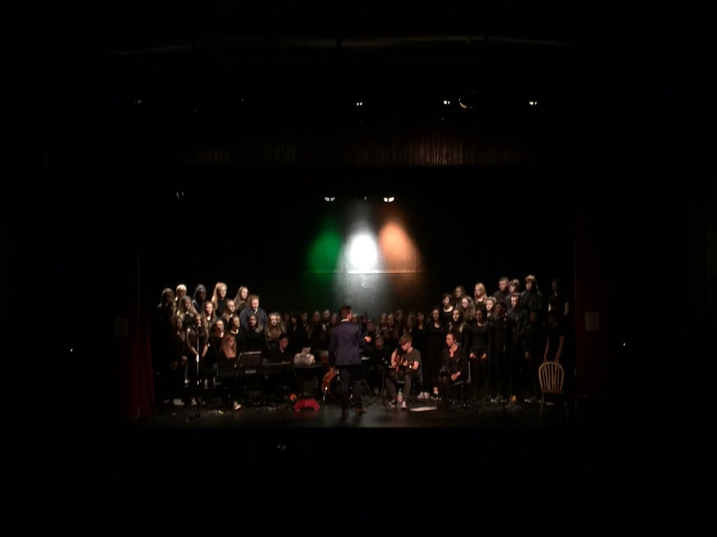
Post TRANSITION YEAR:
“Students who do TY engage better with their studies for leaving certificate than those who do not. They spend significantly more time on homework in senior cycle & are more likely to persist with difficult questions”
(Educational Research Centre, Dublin)

Slide 27
End of year certificate (largely Based on Continuous assessments)
Attendance & Punctuality 10%
Core Subjects
Option Subjects 50%
TY Modules
Work Experience 10%
E-Portfolio
Extra Curricular Involvement 30%
Final Interview & CV
Total 100%

Slide 28
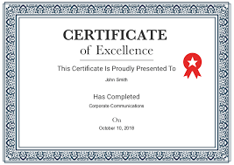
End of year certificate
Percentages Award
30 - 50% Pass
51 - 65% Merit
66 - 80% Higher Merit
81 - 100% Distinction

Slide 29
Cost considerations:
Cost – Programme Fees do not apply.
Activities spread out over the year to help with funding TY. School subsidise where possible & all payments made through “WAY-to-PAY” system.
Fundraising activities encouraged to keep costs at a minimum
Part-time job may help with costs

Slide 30
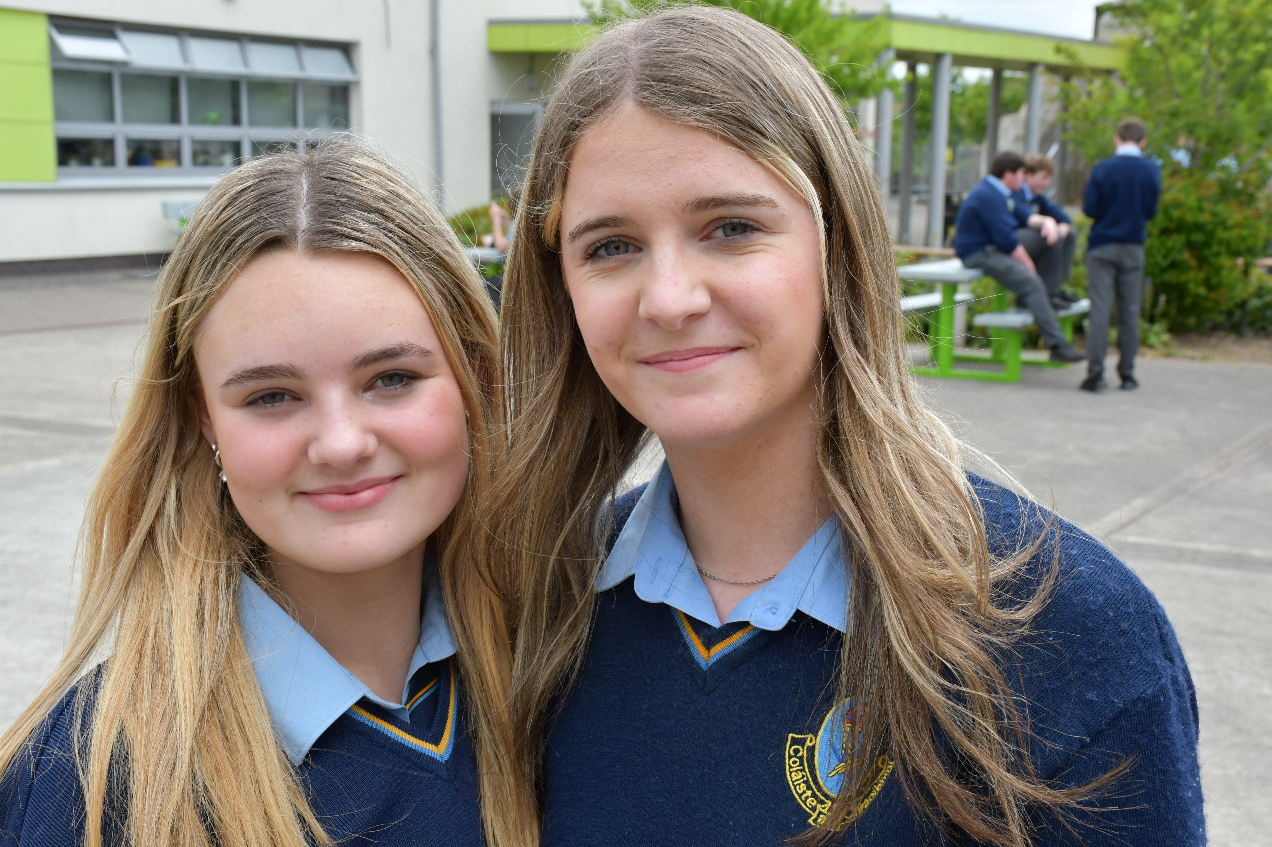
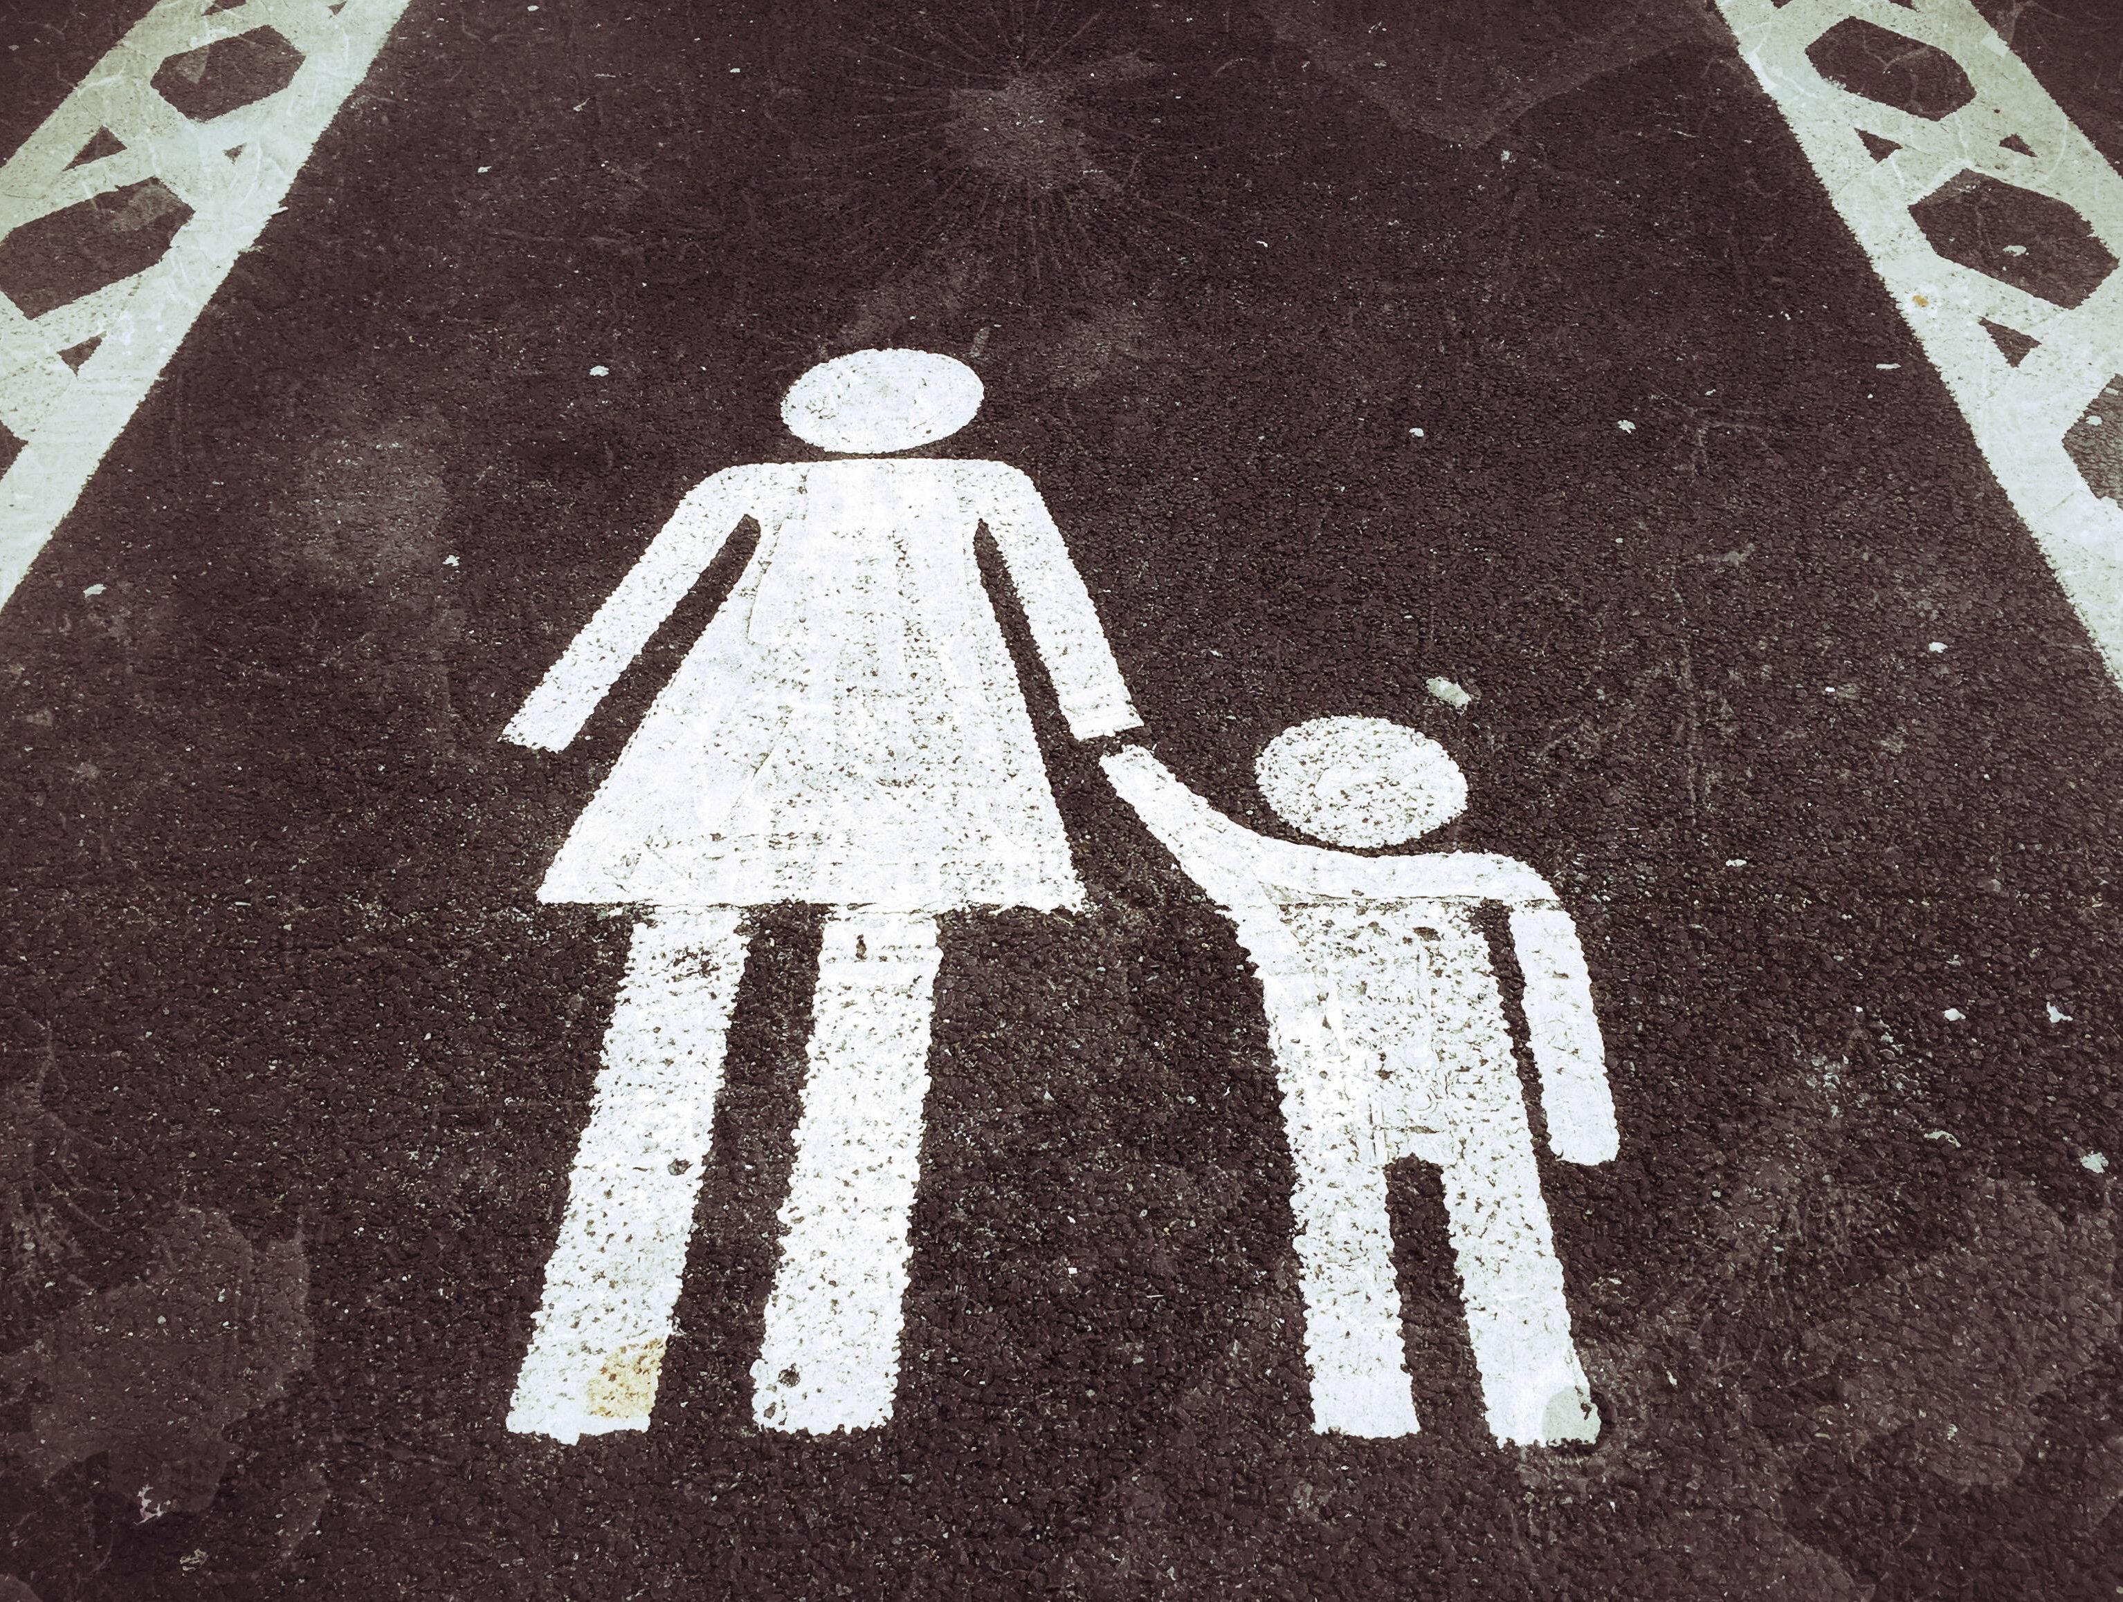
how to help your son/daughter in transition year
PARENT
Encourage
Support
Stay
Informed
Communicate

Slide 31
Important work experience (We had 3 this year):
Monday 13th of November (5 Days)
Tuesday 6th of February (4 Days)
Monday 20th of May (5 days)

Slide 32
TY APPLICATION IS AVAILABLE ON VSWARE FROM MONDAY 4TH OF MARCH TUESDAY 12TH OF MARCH AT 3.30pm!
HOW TO APPLY FOR
TRANSITION YEAR

Slide 33
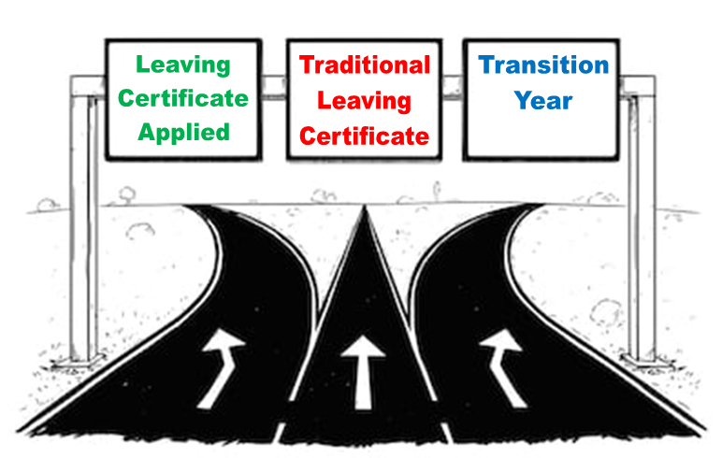
If you have any questions, please email Shane.Stapleton@corketb.ie

